Slide 1
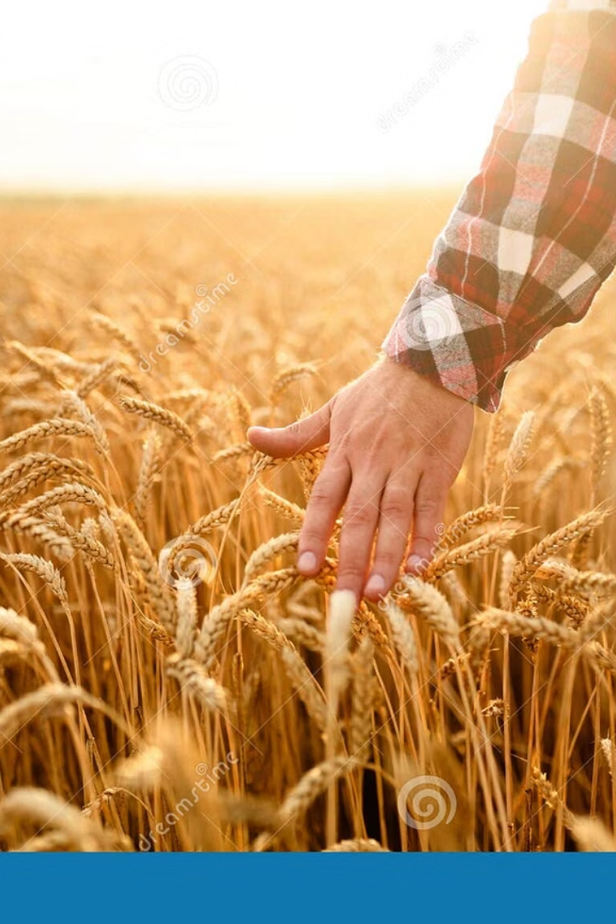
SmartCrop: AI-Powered Crop Recommendation System
SmartCrop optimizes agriculture using machine learning. It recommends the best crop based on soil and weather. This increases yield and reduces resource waste.
TEAM MEMBERS:
SHUBHAM CHAUDHARY(202401100400184)
SUDHAKAR KUMAR(202401100400190)
SUDHANSHU GILL(2024011004000191)
UTKARSH KUMAR SINGH(202401100400202)
VIKRANT BALIYAN(202401100400211)

Slide 2
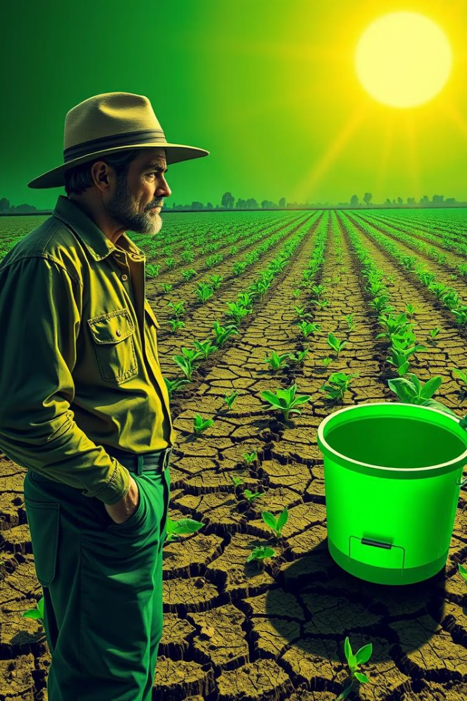
Problem Statement
Suboptimal Crop Selection
Leads to reduced yields and significant losses.
Inefficient Resource Use
Wastes water, fertilizers, and pesticides.
Lack of Real-time Data
Hinders informed decision-making for farmers.
Massive Crop Losses
$33 billion lost in 2023 due to poor decisions.

Slide 3
Data Acquisition and Preprocessing
Key Data Types
Sources & Scale
Preprocessing Steps
Soil data: pH, NPK, moisture, organic matter.
USDA, NOAA, local agricultural offices.
Cleaning: missing values, outlier removal.
Historical yield from 500+ farms in 10 states.
Weather data: temperature, rainfall, humidity, sunlight.
Feature engineering for relevant inputs.

Slide 4

Classification Models
Models Evaluated
Top Performers
Selection Criteria
Random Forest: 92% accuracy.
Logistic Regression, SVM, Random Forest, XGBoost.
XGBoost: 0.91 F1-score for imbalanced classes.
Based on precision, recall, and F1-score.
Hyperparameter tuning via cross-validation.

Slide 5





System Architecture
Cloud-Based Platform
Data Management
Real-time Access
PostgreSQL for soil and historical data.
REST API for recommendations.
Built on AWS for scalability.
User Interface
Intuitive web and mobile app for farmers.

Slide 6
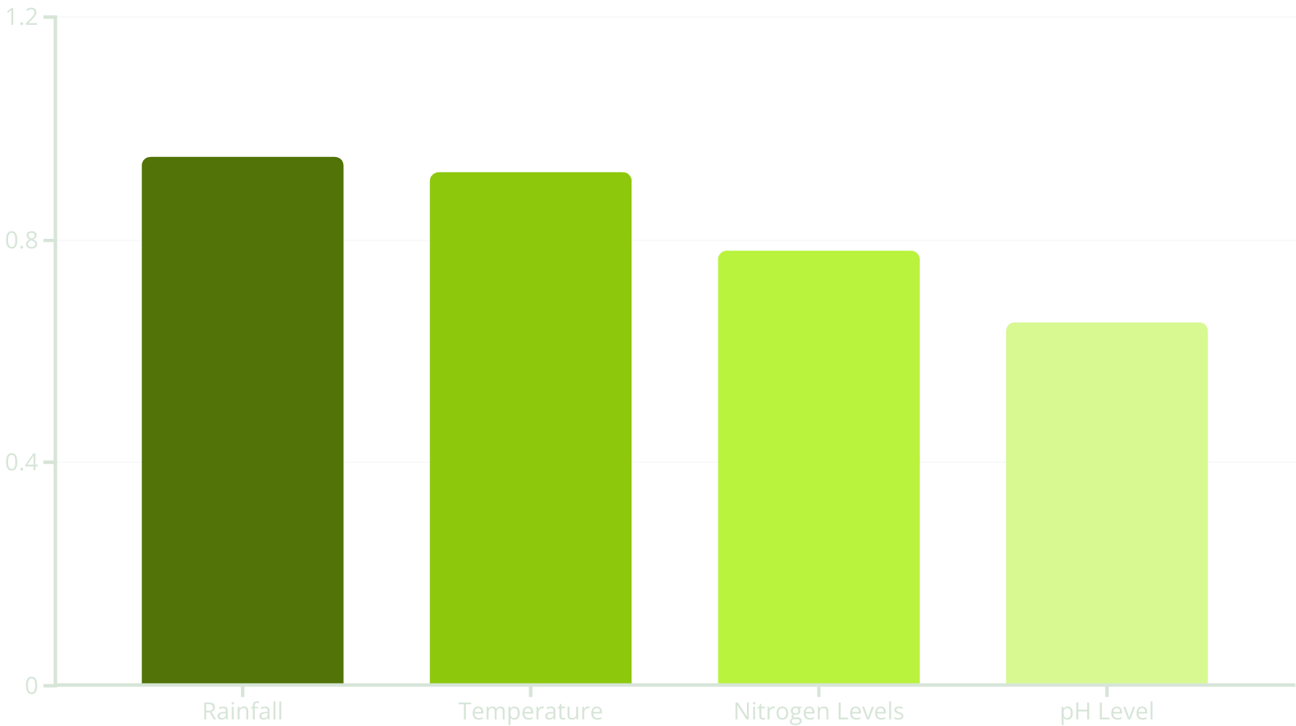
Feature Importance
Rainfall and temperature are primary indicators. Nitrogen levels show secondary importance. pH level helps inform disease resistance of recommendations.

Slide 7

Results and Performance
20%
Yield Increase
Average crop yield increase in pilot farms.
15%
Water Reduction
Decrease in water usage.
10%
Fertilizer Decrease
Reduction in fertilizer consumption.
3x
ROI
Return on investment for early adopters.
Successful deployment across diverse climate zones.

Slide 8
Challenges
Data scarcity in remote areas is a hurdle.
Variability in soil types and weather patterns exists.
Farmer adoption and training is crucial.
Maintaining model accuracy over time is vital.
Ensuring data privacy and security is paramount.

Slide 9
Future Enhancements
Satellite Imagery Integration
For enhanced crop monitoring.
Pest & Disease Prediction
Adding new predictive models.
Personalized Recommendations
Tailored advice for individual farms.
Expanded Coverage
Reaching new regions and diverse crops.
Continuous Improvement
Creating a feedback loop for model refinement.

Slide 10
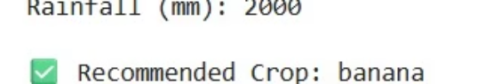
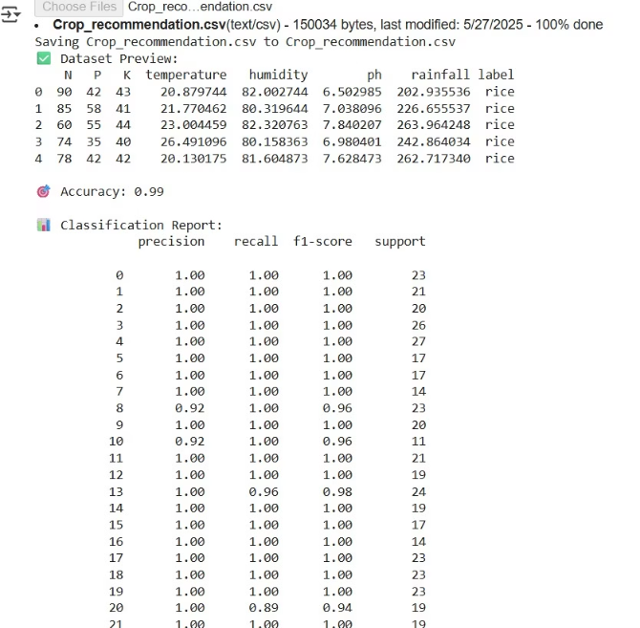
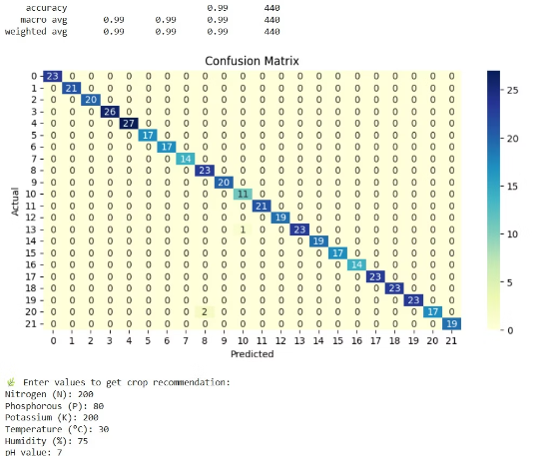
OUTPUT

Slide 11
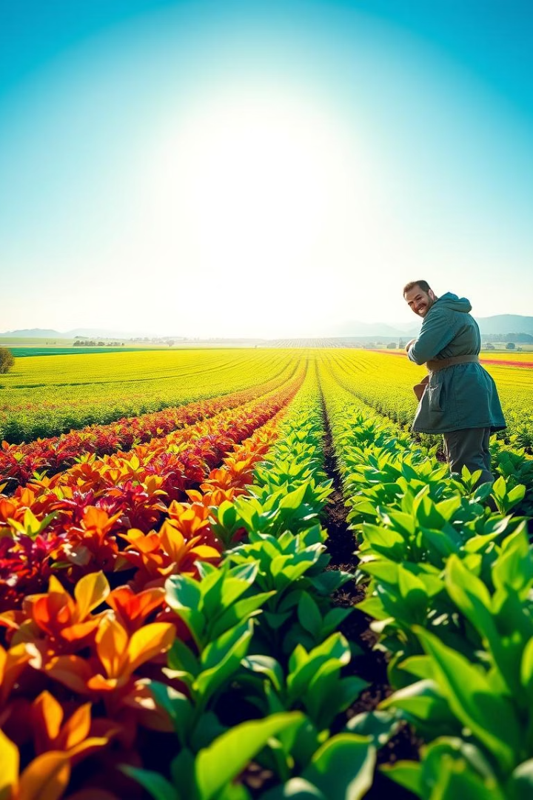
Conclusion
SmartCrop revolutionizes crop selection. It drives data-driven decisions for sustainable agriculture. We improve farmer livelihoods and global food security.

